Slide 1
Decision Trees and Random Forests in Machine Learning
Jason Luce

Slide 2
Decision Trees
What is a decision tree?
Decision support tool that uses a tree-like graph
Shows a map of possible outcome from a series of related choices or data points
More modern name is CART
Classification and Regression Trees
Classification is when the final value is a category (i.e. yes/maybe/no, pass/fail, etc…)
Regression is when the final value is a number (or range of numbers)

Slide 3
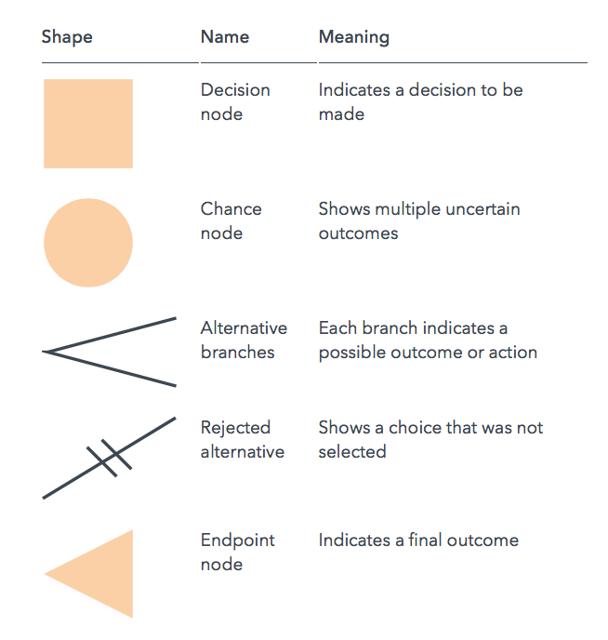
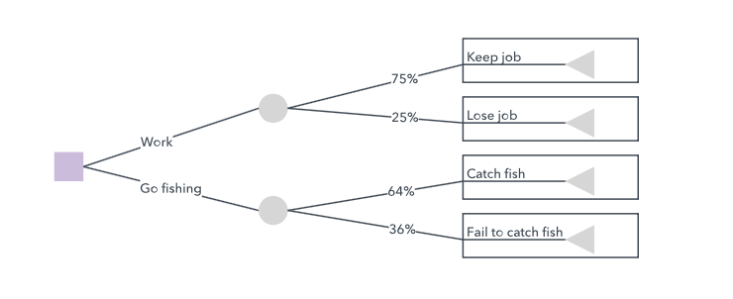
Decision Tree Example
Work or go fishing

Slide 4
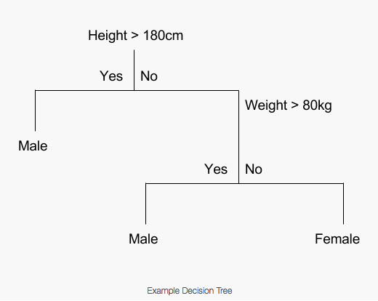
Decision Tree Learning
M/F based on Height or Mass

Slide 5
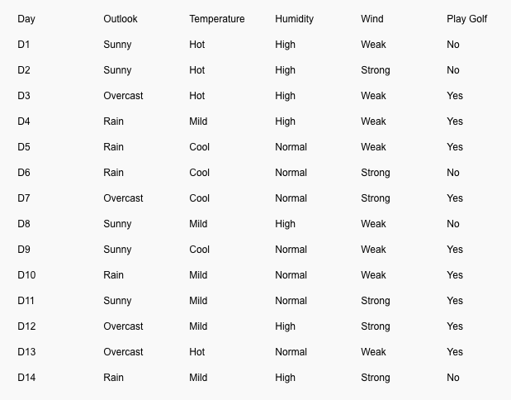
Decision Tree Learning
M/F based on Height or Mass
Splitting points are chosen by minimizing a cost function
Different cost function for regression trees and classification trees
For categories, an example can be seen here:https://www.xoriant.com/blog/product-engineering/decision-trees-machine-learning-algorithm.html
Regression function is similar, except the metric is the sum of the error squared

Slide 6
Decision Tree Learning
Advantages
Simple to understand
Numerical and categorical data
Minimal data preparation
Performs well computationally with large data sets
Mirrors human decision making

Slide 7
Decision Tree Learning
Disadvantages
Less accurate than other training methods
Not very robust, i.e. small changes in training data can result in large changes in final prediction
Tendency towards overly-complex trees that do not generalize well (overfitting)

Slide 8
Random Forests
Random Forest methods offer a way to overcome many of the disadvantages of decision tree learning

Slide 9
Random Forests
Random Forest methods offer a way to overcome many of the disadvantages of decision tree learning
Average multiple decision trees trained on different parts of the same training set
Uses bootstrap aggregating, i.e. ‘bagging’ to generate data sets.

Slide 10
Bagging
Given a training set D of size n, bagging creates m new training sets, D_{i,} each of size n’
Samples uniformly from D with replacement (i.e. possible to sample the same data twice)
For large n, if n = n’ then each D_{i} is expected to have ~ 63% unique samples from D.
m decision trees are trained using the m training sets and combined by averaging the results (regression) or voting (classification)

Slide 11
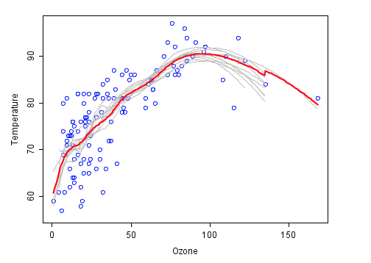
Example of Bagging
Analysis of ozone (ppm?) and temperature
LOESS smoother (a type of polynomial regression algorithm) is used to model the relationship
Blue dots are data points
Grey lines are first 10 (out of 100) of the LOESS smoother fits on bagged data sets
Red line is the average of the 100 LOESS smoother fits

Slide 12
Questions?

